Slide 1
Office 365 Development

Slide 2
Getting started with Office Add-ins

Slide 3

Agenda
Intro to the add-in model
Office Add-ins
Getting started

Slide 4
Developer vision
USERS
DATA
HTML
Notes:
Our Office 365 developer vision focuses on the Users’ experience and their data. As a developer you can bring your applications into their user experience. With over 1.2+ billion users of Office Worldwide, this is a huge opportunity to provide a window into your applications. As well as being able to connect into their data and add intelligence to your applications. There are currently 850 million events created a month and a total of 470Pb+ of data stored in the service that can add value to for our Users’.

Slide 5
Intro to the Office Add-ins

Slide 6
Contextual Add-ins
Surface your Add-ins in the Office 365 platform
In context of your business users productivity activities
In Office Client, Office Online, and modern Add-ins

Slide 7
Introducing the Add-in model
Office add-ins do not “live” on the Office client
Custom code executes in the client, cloud or on-premises
Acquire Add-ins via centralized location
Add-in catalog (SharePoint or FileShare)
Public store (via submission process)
APIs for manual deployment
Notes:
To address many of the challenges developers and site owners had in previous versions of SharePoint, Microsoft has introduced a new development option for SharePoint 2013: The SharePoint Add-in Model.
In this new model add-ins do not necessary live within SharePoint. Instead the add-in’s business logic executes within the context of the client (browser) or externally from SharePoint. This external option could be another non-SharePoint Web server or a cloud server. Add-ins are also more secure in that when they need to access SharePoint resources such as lists and libraries they must be explicitly granted permissions to do so. This is implemented using OAuth. When an add-in is created, the developer specifies which permission the add-in needs in order to function. When the add-in is installed, the user installing the add-in is prompted to accept the permission requests the add-in needs (if they deny the permissions, the add-in is not installed). Once granted permissions, the add-ins can then talk to SharePoint using the Client Side Object Model (CSOM) or using some of the new OData services in SharePoint.
Developers can build add-ins and submit them to a marketplace making it easy for customers to acquire these applications.

Slide 8






Modern Add-in development
Add-ins
Products and platforms
Services and data
Expense
calculator
Vacation
request
Event
planning
Help-desk
support
Learning management
Risk
management
Add-in catalog and store
Notes:
It’s worth spending some time taking you through how we think about modern add-in development at Microsoft. We have a series of products and platforms like SharePoint and Office that provide a lot of great out-of-the box functionality to help us be productive. To get even more from these products we want to be able to bring information in from other places. Services and data sources like Dynamics, Bing or something that lives out on the web or in the cloud.
With the latest version of SharePoint we’re making it easier to bring together rich web services and data to create powerful new add-ins. Add-ins run outside of the SharePoint process, are hosted externally and can be exposed through REST API’s.
Today there are more than 700,000 SharePoint application developers and with this release we’re providing them with a place to surface their add-ins through an online marketplace of rich partner solutions and applications designed to work with SharePoint and Office.

Slide 9
demo
Adding your first add-in
Notes:
Demo PeopleGraph in Excel

Slide 10
Office Add-ins

Slide 11
Office 2013/2016 development scenarios
Web and cross-device ready
Integrate rich web content in Office content
Include contextual content within Office Add-ins
Pre-Office 2013
Office 2013/2016
Extending Office ribbon
COM Add-in
Extending Office ribbon
COM Add-in
Office Add-ins
SharePoint Add-ins
Macro
VSTO
Macro
VSTO
Document template
Notes:
Office 2013/2016 will continue to support the extensibility models of previous version of the Office suite. Some of these options included using things like COM Add-Ins, Macros, extensions built using Visual Studio Tools for Office (VSTO) or extending the ribbon. As with any new version, developers are strongly recommended to test these customizations in the latest version of Office 2013.
The new Office 2013 extensibility model that is recommended for developers to leverage when customizing Office 2013 is to build add-ins. An Add-in is founded on standard Web technologies such as HTML & JavaScript. Because they are founded on web technologies, they can generally be used in both the Office 2013 desktop and web clients. This architecture also means that they are friendly to multiple devices since they are simply executing Web technologies.

Slide 12
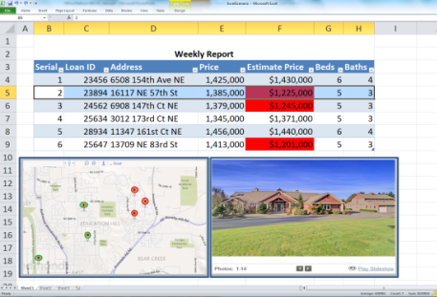

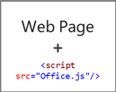


Anatomy
Web server
Office Store or
SharePoint add-in catalog

Slide 13
Office Add-ins A new way to build extensions for Office
Contextual Mail Add-in
Add-in launched contextually from a mail message or appointment
Outlook and Outlook Web Access (OWA)
Task Pane Add-in
Add-in that runs beside a document/mail with read/write access
Word, Excel, PowerPoint, Project, Outlook
Content Add-in
Add-in that runs within a document content with read/write access
Excel, PowerPoint, Access
Add-in Command
Command in the Office UI to launch add-in or perform UI-less operation
Outlook, Outlook Web Access (OWA)

Slide 14
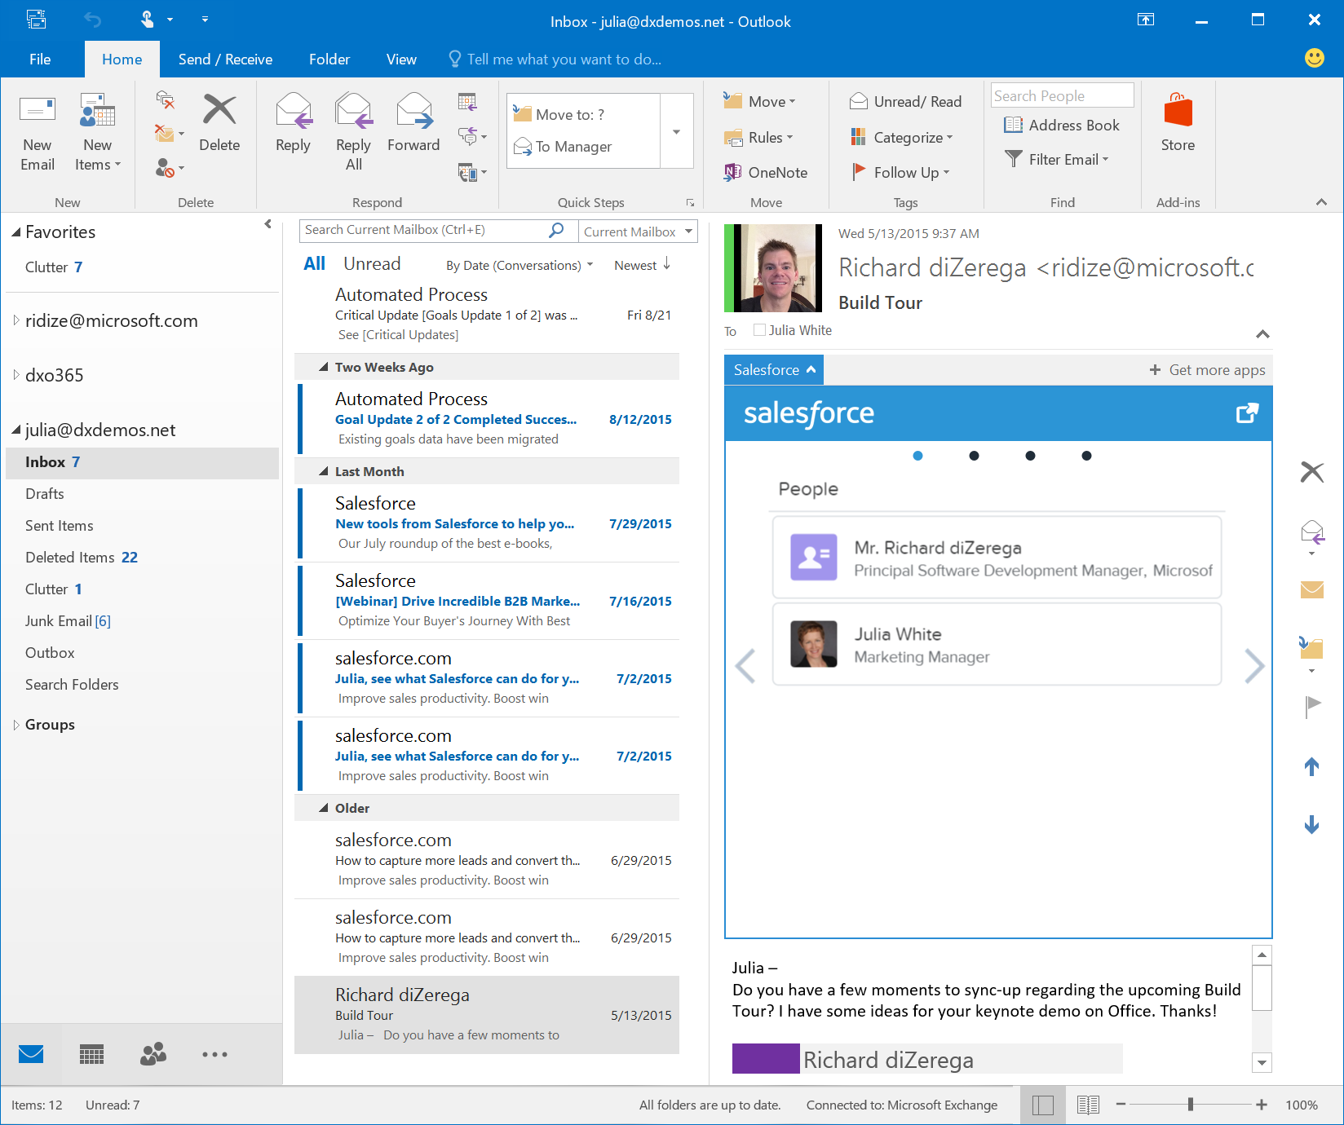
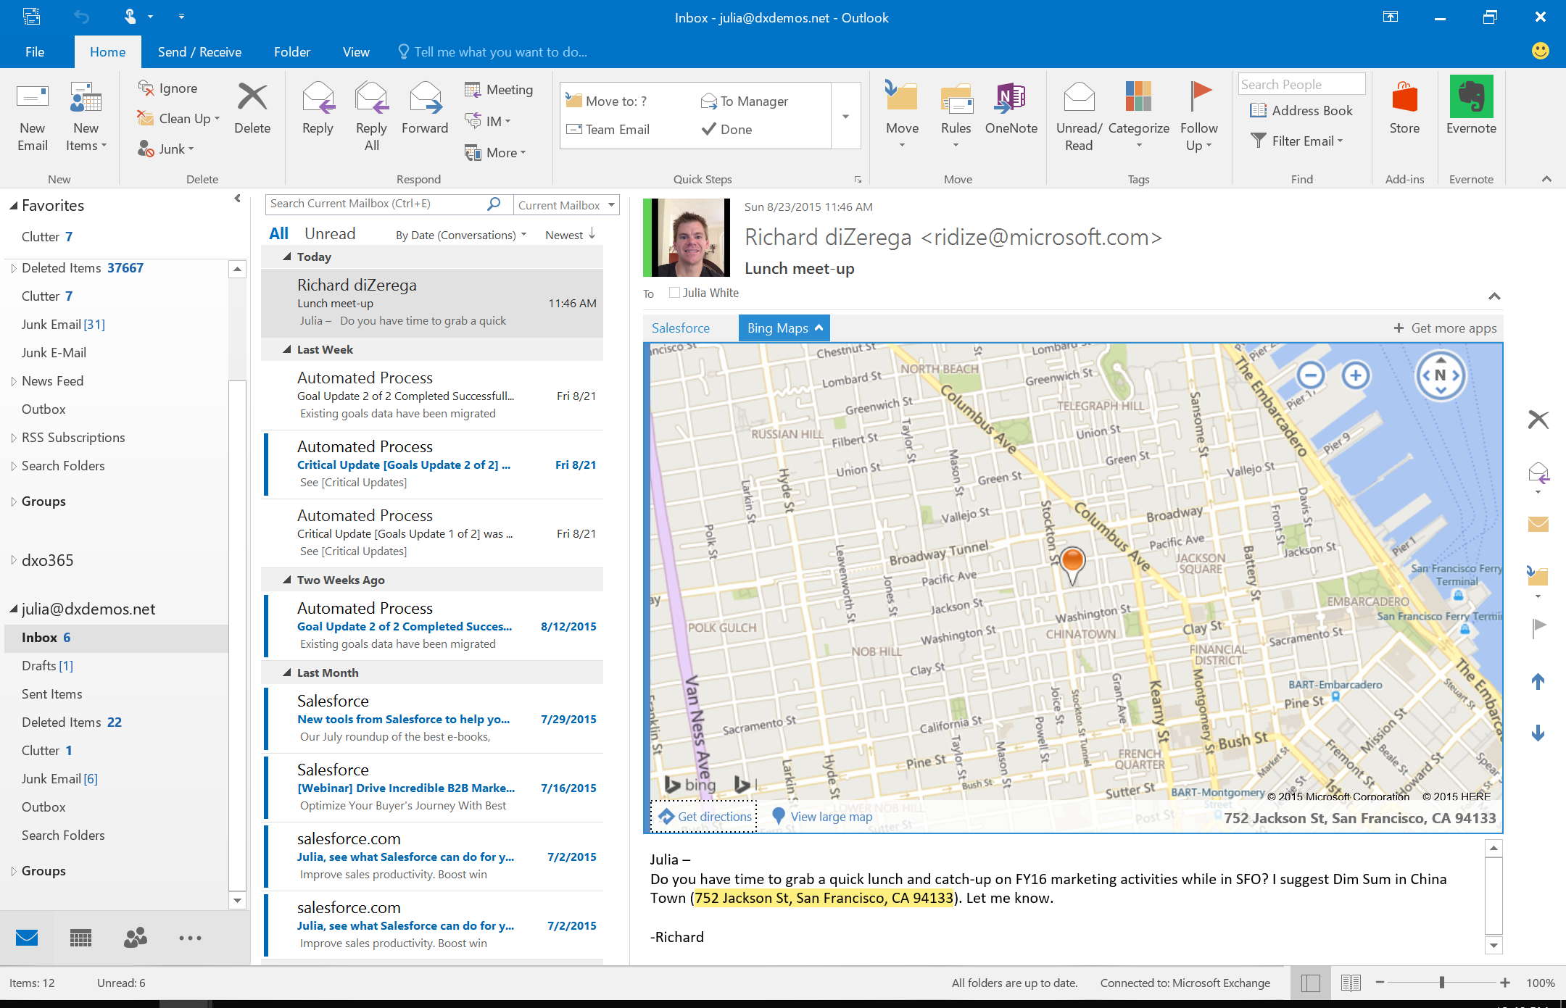
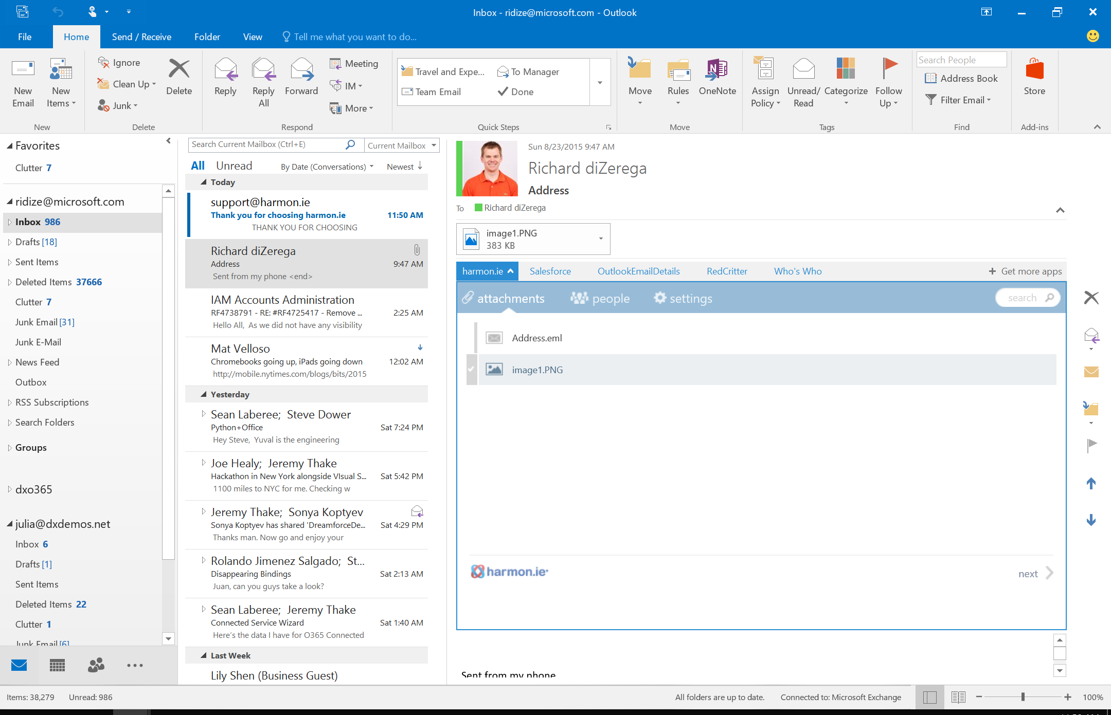
Contextual Mail Add-in

Slide 15
Office Add-ins A new way to build extensions for Office
Contextual Mail Add-in
Add-in launched contextually from a mail message or appointment
Outlook and Outlook Web Access (OWA)
Task Pane Add-in
Add-in that runs beside a document/mail with read/write access
Word, Excel, PowerPoint, Project, Outlook
Content Add-in
Add-in that runs within a document content with read/write access
Excel, PowerPoint, Access
Add-in Command
Command in the Office UI to launch add-in or perform UI-less operation
Outlook, Outlook Web Access (OWA)

Slide 16
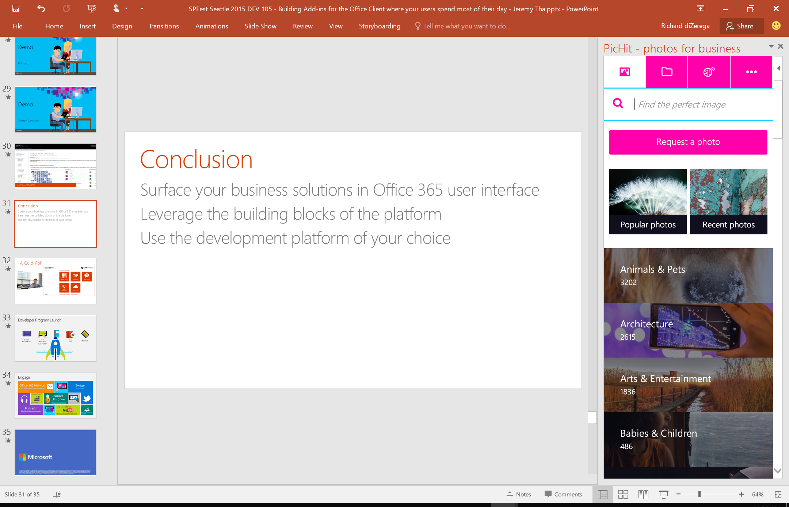
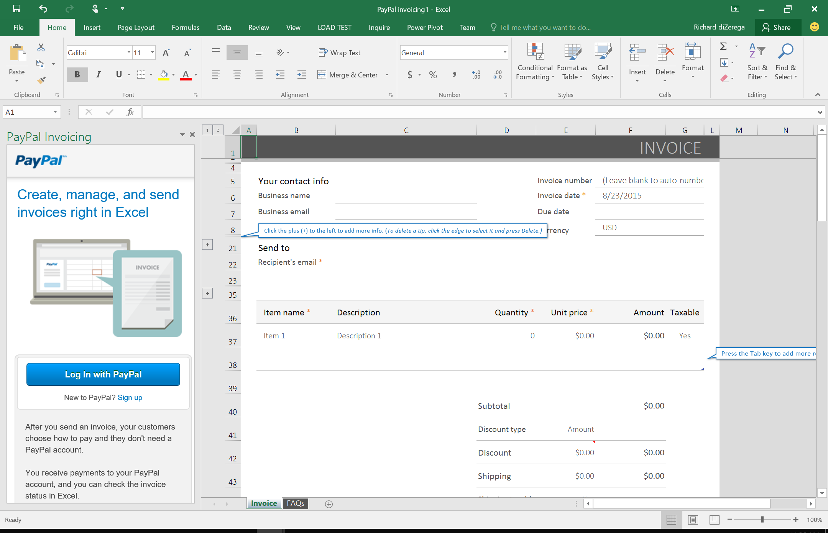
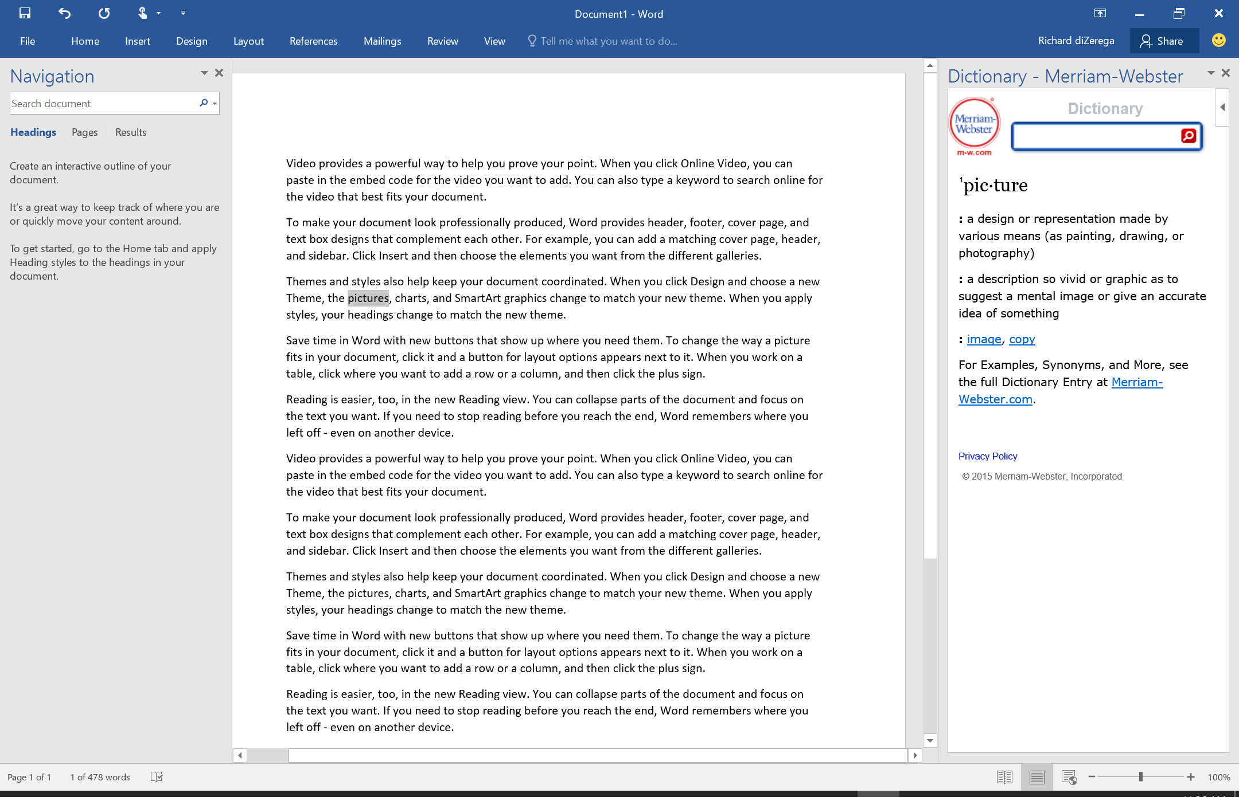
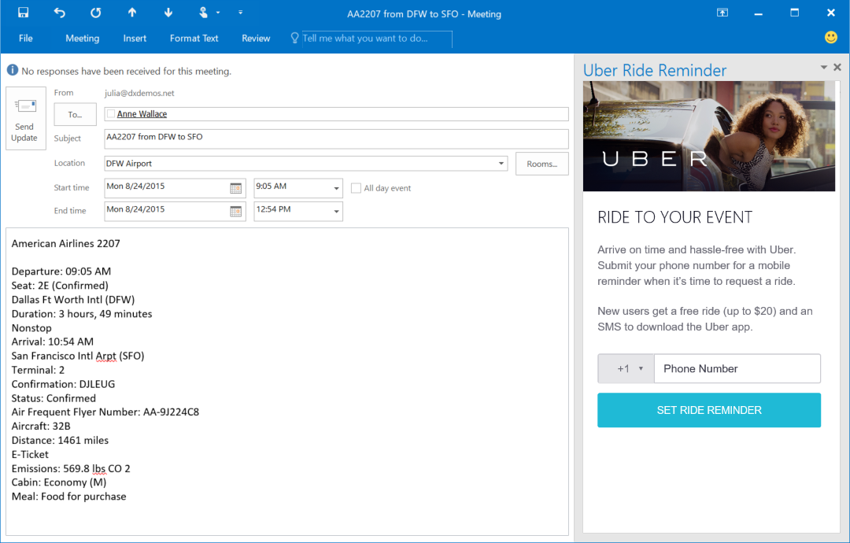
Task Pane Add-in

Slide 17
Office Add-ins A new way to build extensions for Office
Contextual Mail Add-in
Add-in launched contextually from a mail message or appointment
Outlook and Outlook Web Access (OWA)
Task Pane Add-in
Add-in that runs beside a document/mail with read/write access
Word, Excel, PowerPoint, Project, Outlook
Content Add-in
Add-in that runs within a document content with read/write access
Excel, PowerPoint, Access
Add-in Command
Command in the Office UI to launch add-in or perform UI-less operation
Outlook, Outlook Web Access (OWA)

Slide 18
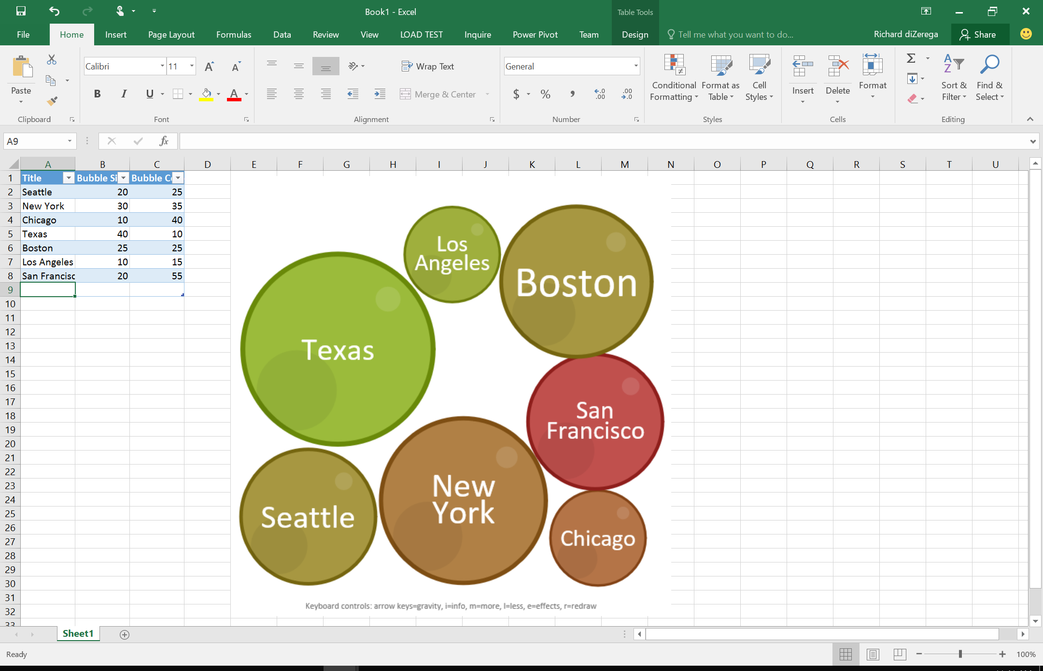
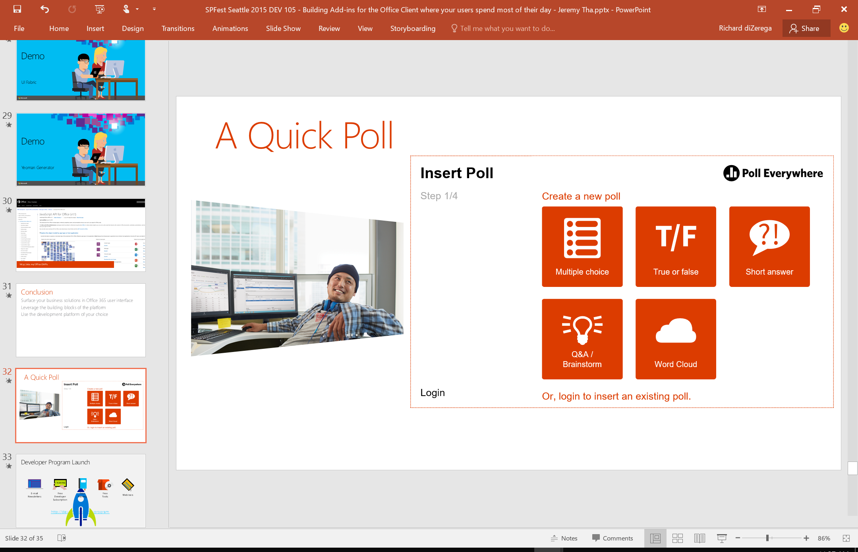
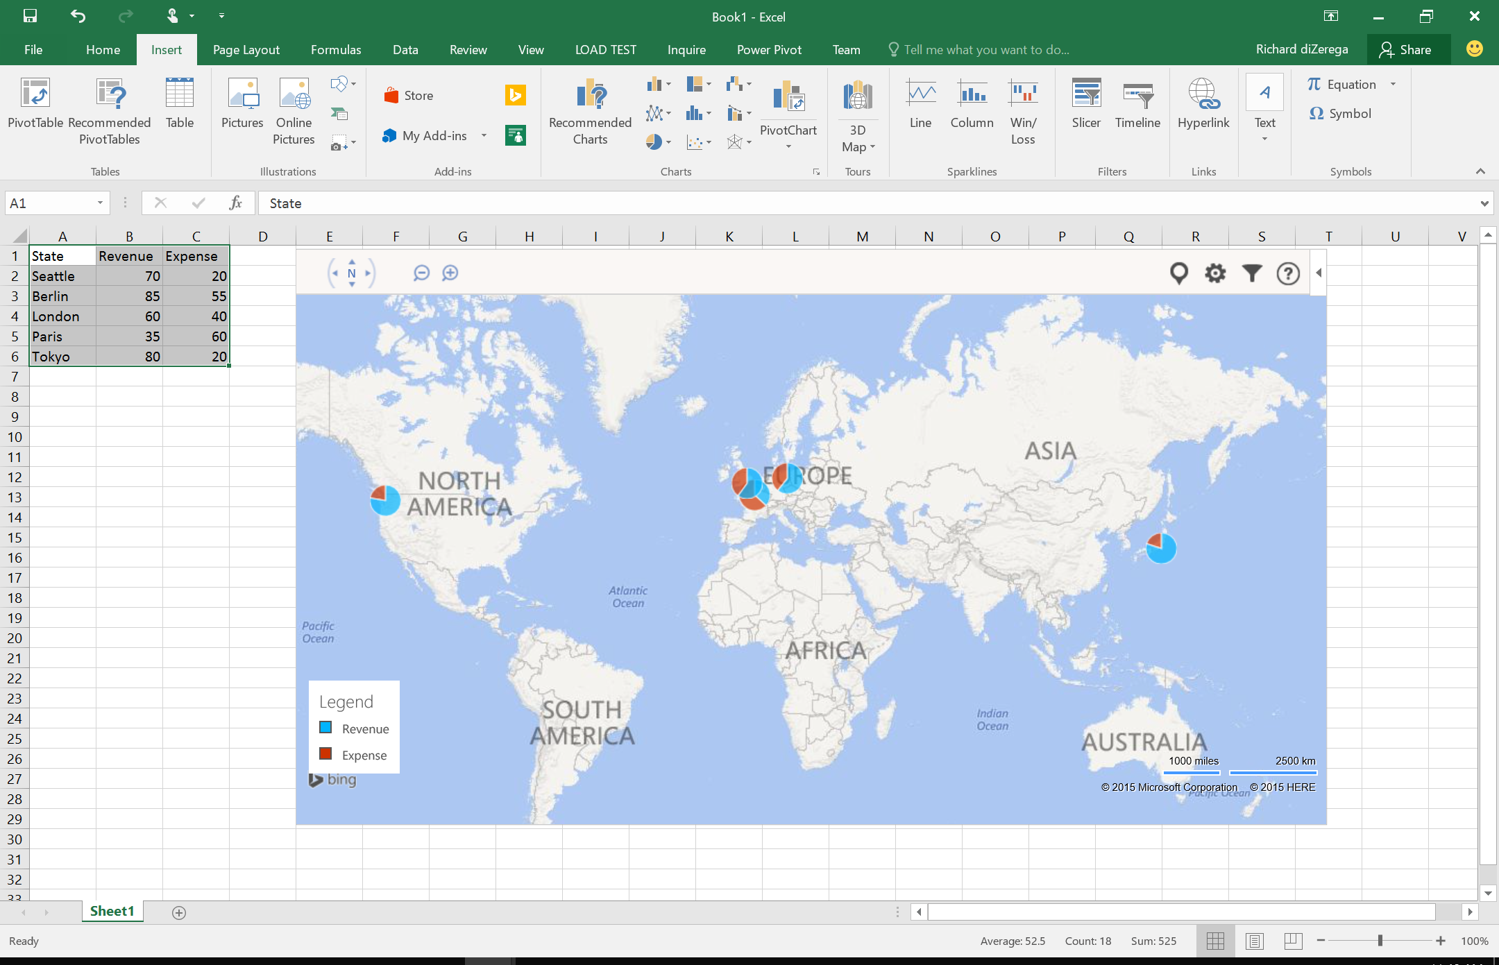
Content Add-in

Slide 19
Office Add-ins A new way to build extensions for Office
Contextual Mail Add-in
Add-in launched contextually from a mail message or appointment
Outlook and Outlook Web Access (OWA)
Task Pane Add-in
Add-in that runs beside a document/mail with read/write access
Word, Excel, PowerPoint, Project, Outlook
Content Add-in
Add-in that runs within a document content with read/write access
Excel, PowerPoint, Access
Add-in Command
Command in the Office UI to launch add-in or perform UI-less operation
Outlook, Outlook Web Access (OWA)

Slide 20
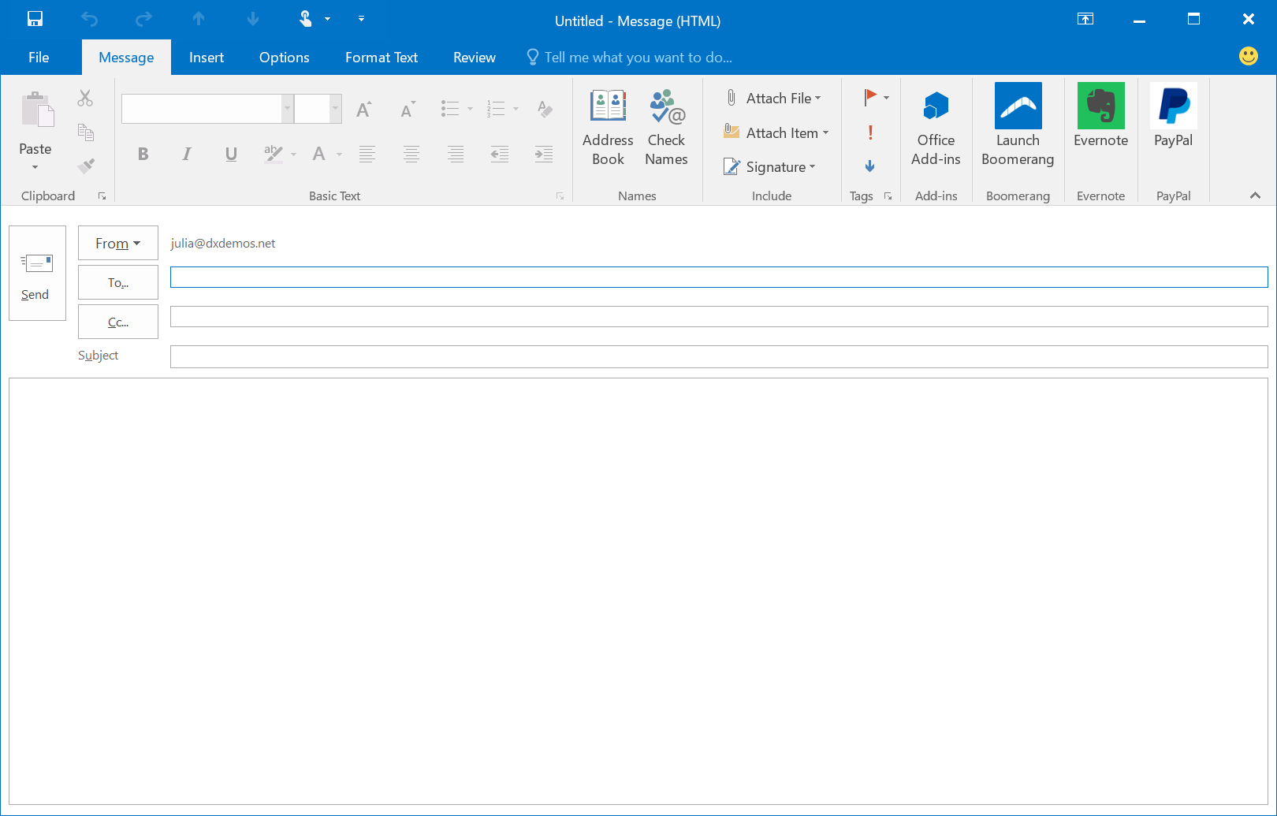
Add-in Command

Slide 21
demo
Office add-in samples
Notes:
Poll Everywhere from PPTX
Bubbles in Excel
DocuSign in Word
Boomerang in Outlook

Slide 22
Getting started

Slide 23
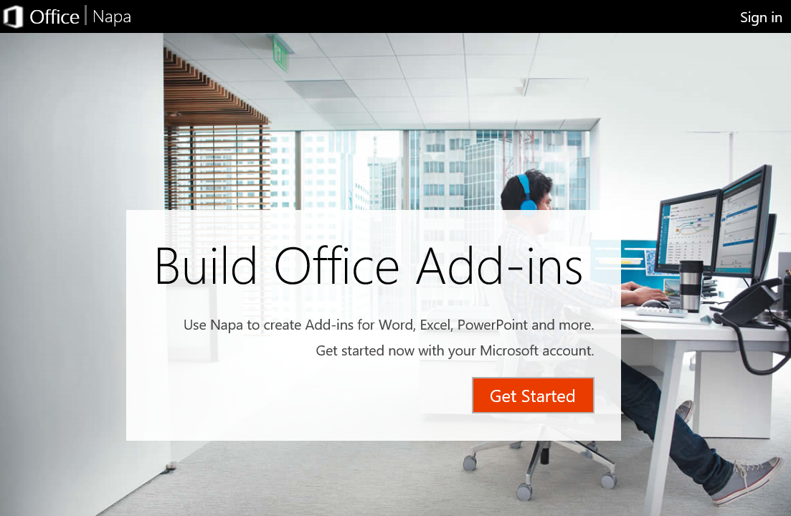
Development Options – Napa
In-browser web editor for building client-side Office Add-ins
Uses Office Online and OneDrive for file storage
Intellisense for JavaScript and HTML5
Allows for sharing and exporting
Doesn’t expose full Add-in manifest

Slide 24

Development Options – Visual Studio
First-class development experience with templates and debugging
Exposes the full Add-in manifest and automated deployment commands
Allows for web projects containing both client-side and server-side assets

Slide 25

Development Options – Other
You can use anything that delivers for the web
Microsoft offering Yeoman generator for skeleton Add-in project
Keep in mind that add-ins need SSL/HTTPS

Slide 26

Office UI Fabric
Responsive, mobile-first, front-end framework for developers that delivers instant look and feel of Office
Handles typography, color, icons, animations, responsive grid layouts and localization

Slide 27
demo
Building your first office add-in

Slide 28






Add-in Roadmap
 | Win32 | Online | iPad | iPhone | Mac | Android | UWA
 |  |  |  |  | Read
 |  |  |  |  | Compose
 |  | APIs
 |  | View
 |  | Edit
Today
Next
Backlog
Notes:
ROBLE

Slide 29
Conclusion
Surface your business solutions in Office 365 user interface
Leverage the building blocks of the platform
Use the development platform of your choice

Slide 30
Summary
Intro to the add-in model
Office Add-ins
Getting started

Slide 31
Further reading…
Getting Started with Office add-ins
Office Add-in Code Samples
Office Add-in Training videos & hands on labs
Office Add-in Snack videos
Office Add-in documentation

Slide 32
Developer Program Launch
1 YEAR FREE
E-mail Newsletters
Free Developer Subscription
Free Training
Free Tools
Webinars
http://dev.office.com/devprogram

Slide 33


Engage
Office 365 Network
https://www.yammer.com/itpronetwork
Twitter
S
S
t
t
a
a
r
r
t
t
@OfficeDev
Stack overflow
[ms-office]
Channel 9 Dev Show
http://aka.ms/O365DevShow
Podcasts http://dev.office.com/podcasts
Snack Demos
http://aka.ms/o365DevSnackDemos
UserVoice
http://officespdev.uservoice.com/

